Slide 1
The Battle of Neighborhoods

Slide 2
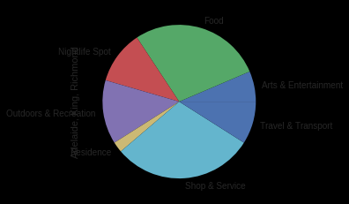
Business Problem
A company want to relocate from Toronto to New York. It wants to find a similar borough by venue composition. In other words, we don't use the venue number directly, in stead we use the percentage contribution of categories , say Arts & Entertainment, Food, Nightlife Spot, Outdoors & Recreation, Residence, Shop & Service and Travel & Transport.

Slide 3
Data
Toronto Data: Use the Notebook to build the code to scrape the following Wikipedia page, https://en.wikipedia.org/wiki/List_of_postal_codes_of_Canada:_M.
New York Data: The link to the dataset of New York: https://geo.nyu.edu/catalog/nyu_2451_34572
Foursquare Data: We get the venues and their categories data from Foursquare.com .

Slide 4
The primary challenge
The primary challenge is to fetch data from Foursquare. For every call, there is a limit of 50 venues to return. So in order to fetch more data, If we make venue search calls by category. If we fetch data for all categories, the dataset could have millions of rows. But due to the calle limit, It definitely fail for every time. So we categorize the data into only 7 top categories. As a balance, we fetch data by 7 primary categories. And in order to limit the results per call, we choose a small radius.

Slide 5
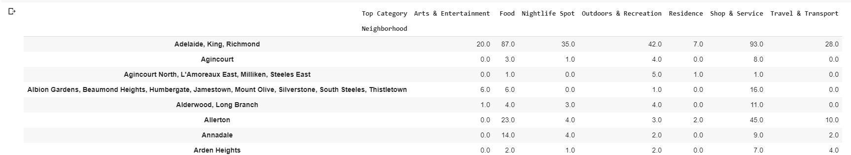
The Steps (1)
We statistics the venue data and form the pivot table as the following:

Slide 6
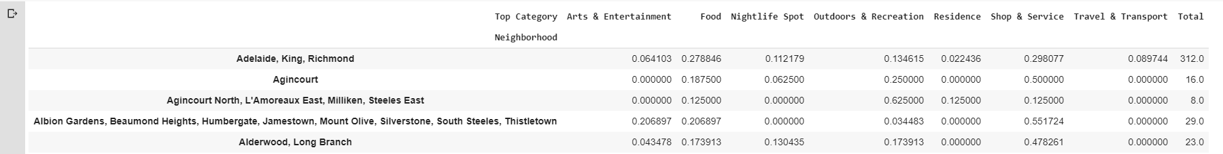
The Steps (2)
We use category count per borough/ Total venues per borough to make the data percent based.

Slide 7
The steps (3)
We use the K means cluster of SKLearn to cluster the boroughs. In order to find the best K parameter. We will use GridSearch.

Slide 8
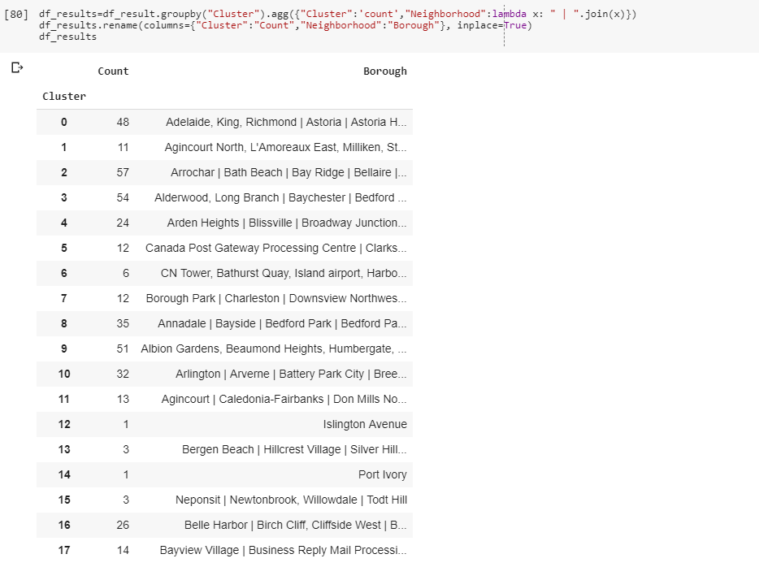
The results
So we can cluster the boroughs of Toronto and New York together.

Slide 9
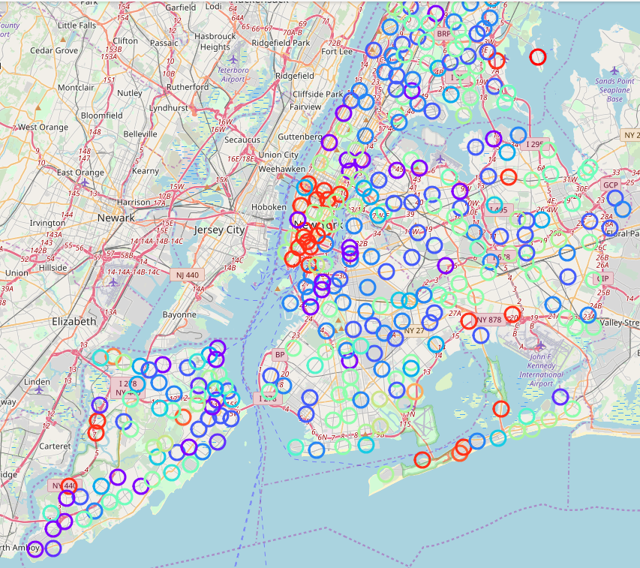
The results on map
Visually, the cluster of New York is as the following:

